Slide 1


Using Social Media To Enhance Emergency Situation Awareness
Engineering in Computer Science
Data Mining, ay 2020/2021
28/01/2021

Slide 2
The Team
Hamza Bouzidi : Tweet Filtering
David Guzman : Online Clustering

Slide 3
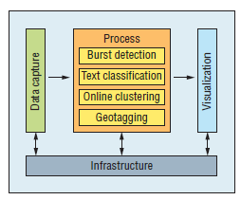
Motivations
Reference paper:
J. Yin, A. Lampert, M. Cameron, B. Robinson and R. Power, "Using Social Media to Enhance Emergency Situation Awareness," in IEEE Intelligent Systems, vol. 27, no. 6, pp. 52-59, Nov.-Dec. 2012, doi: 10.1109/MIS.2012.6.
Motivation and goals:
> SITUATION AWARENESS
(perception + comprehension + projection)
NLP, ML, Data Mining
tweets during crisis
ubiquity
communication rapidity
cross-platform accessibility
real-time nature
knowledge for emergency response
emergency management
crisis coordination
decision making
Notes:
SITUATION AWARENESS is defined as : (i) perception, (ii) comprehension, (iii) projection
gathering info about outbreak of disaster => burst detection
about affected area => geotagging
understand type of disaster, impact, damage => tweet filtering, clustering
Use NLP, Data Mining, ML techniques to extract situation awareness information from tweets generated during disasters and crises, to improve emergency management, crisis coordination and decision making. The key points to attack is the detection, classification and grouping of tweets related to disasters.

Slide 4
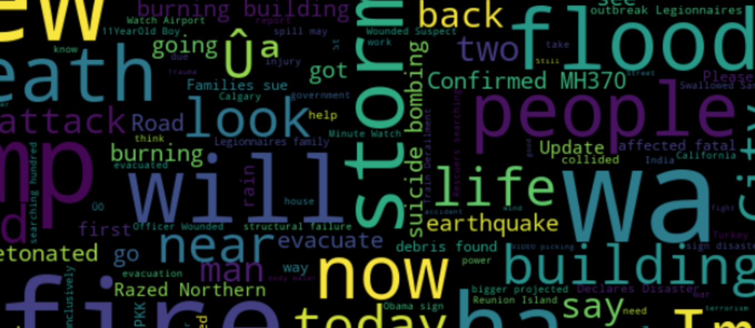
Binary Classification : Real or not?
Dataset and ground truth:
.csv extracted from Kaggle
labelled (1=real, 0=not real)
10,000 tweets related to disasters that were hand classified.
word cloud representation.
Data cleaning:
Basic cleaning (spelling correction, removing punctuations, removing html tags, and emojis)
Tfidf vectorization to represent the words.
Assumptions and simplifications:
Each sample in the train and test set has the text of the tweet, a keyword from tweet, and location of the tweet has been taken.
Tf-Idf for text representation, min_df = 5 to ignore terms that appear in less than 5 tweets.
Evaluation metrics:
Precision, Recall, F1.
{word cloud representation}

Slide 5
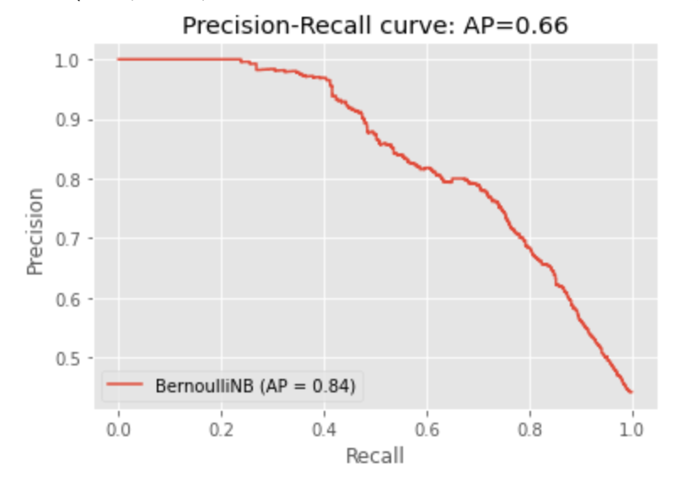
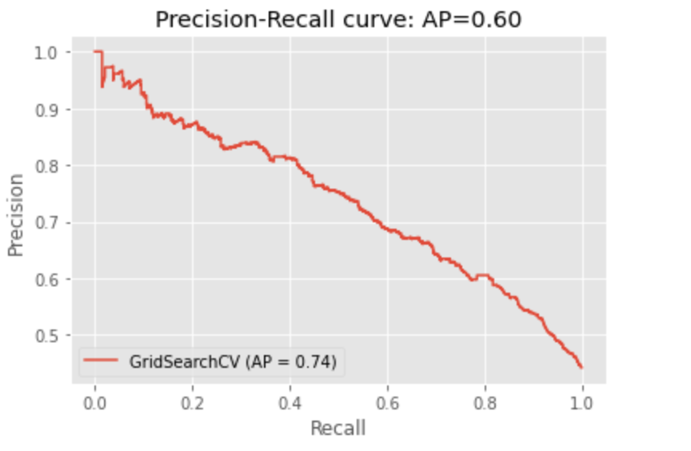
Binary Classification : results
non-linear SVM with polynomial kernel gets lower results for recall, precision and accuracy than Naive Bayes, with a F1 score of 0.63
Both Bernoulli and Multinomial Naive Bayes get a F1 score of 0,7.

Slide 6
Multiclass Classification : which category?
Data cleaning:
same data cleaning techniques used for binary classification
Tfidf vectorization to represent the words.
Assumptions and simplifications:
only “tweet_text” and “category” columns considered
category represented as integer, dictionary for integer-name category mapping
most correlated unigrams and bigrams for each category
Evaluation metrics:
Precision, Recall, F1 score.
Dataset and ground truth:
.csv extracted from CrisisNLP
tweets belonging to multiple datasets, (earthquake, typhoon, volcano, floods, MERS).
Dealing with the dataset:
Combine the multiple datasets and modify the attributes to appear uniformly for all tweets, into a single .csv file.
1711 tweets in total (small dataset)
labelled (category of tweet)

Slide 7
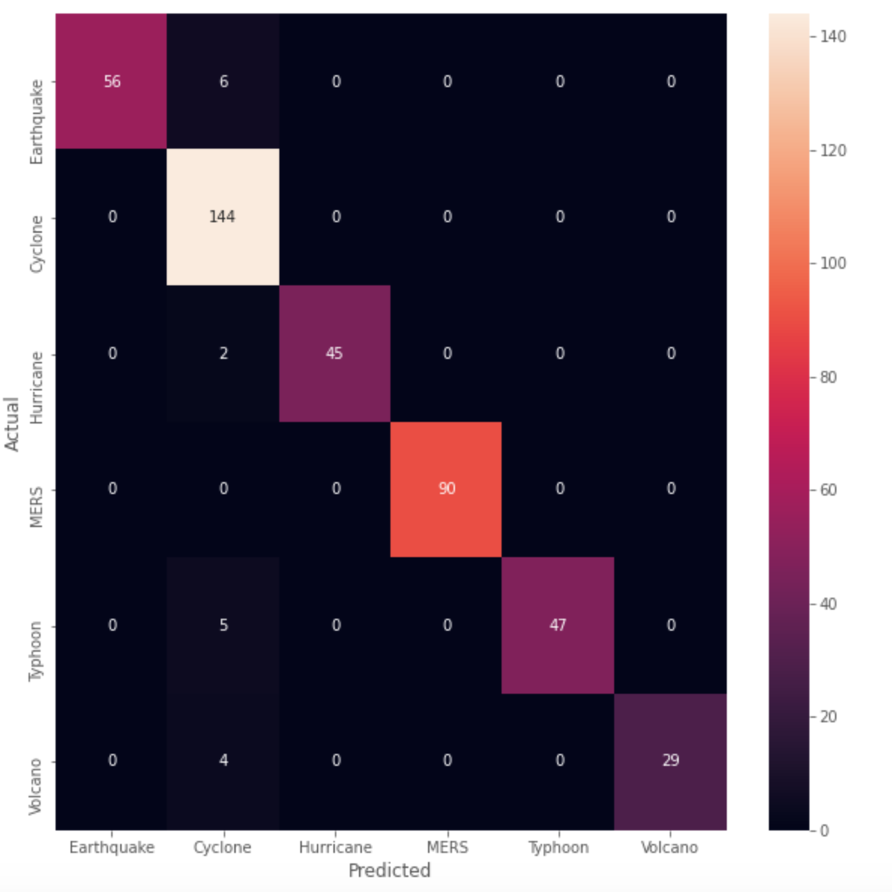
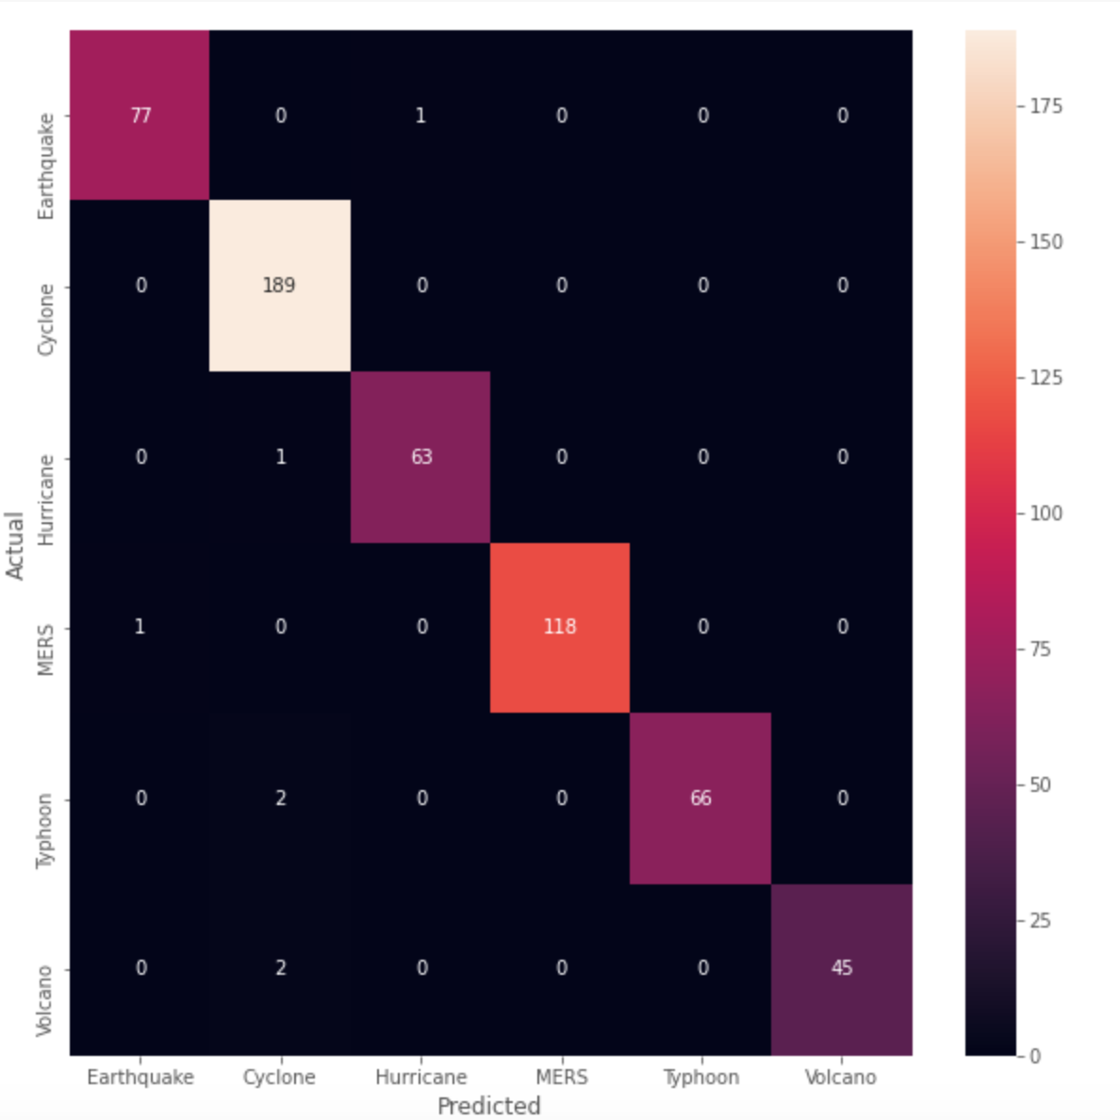
Multiclass Classification: results
Multinomial NB
F1-score = 0.94
Linear SVM (best model)
F1-score = 0.98
some test samples tend to be misclassified as ’earthquake’, due to small size and imbalance of dataset
!! small datasets tend to overfit !!

Slide 8
Online Clustering: methodology
Dataset and ground truth:
.csv extracted from CrisisNLP
human-labeled tweets
3000 tweets related to natural disasters
Earthquake, Hurricane, Volcano, MERS, Typhon, Cyclone, Airplane disaster
Assumptions and simplifications:
No time distance between tweets.
No prefiltering of unimportant tweets (No usage of burst-detection)
About the model:
Text preprocessing (tokenization, stop words, remove of frequent words, etc)
Tf-idf representation of the tweets using tf-idf vectorizer
Online incremental clustering
Similarity measures: cosine and jaccard coefficient
Evaluation metrics:
Clustering quality through comparison with offline clustering
We know in advance the number of labels on dataset
Clustering quality using the Silhouette score

Slide 9
Online Clustering: results (1/3)
Online incremental clustering leads to a big number of clusters (same results as in paper). Because of that, we configured next hyperparameters:
Tf-idf vectorizer:
min_df -> in order to ignore terms with df lower than the 0.07 which means terms present in most of documents. This plays against the number of relevant tweets. Some of them got a zero-vector representation
Similarity threshold: defined as 0.2 as the minimal value to assign a tweet to a cluster. Otherwise, create another cluster.

Slide 10
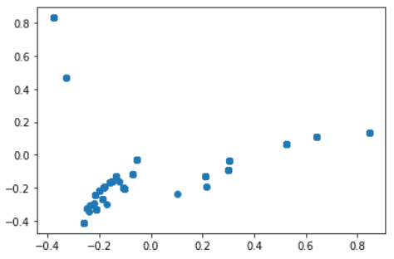
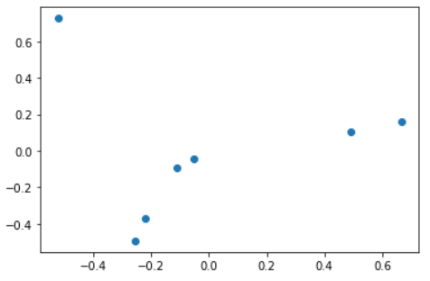
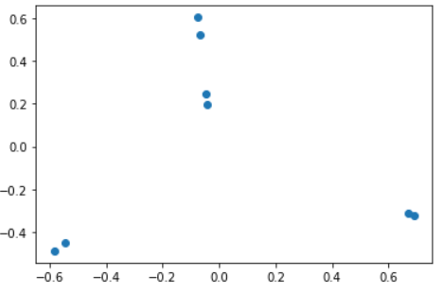
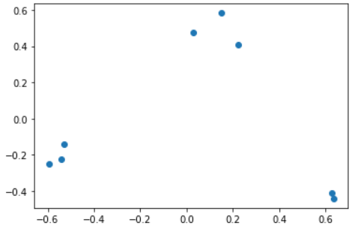
Online Clustering: results (2/3)
Tweets
K-means
Silhouette score = 0.75
Cosine
Silhouette score = 0.59
Jaccard
Silhouette score = 0.64

Slide 11
results
(3/3)
MODEL | N CLUSTERS | CLUSTERS CENTROIDS
K-MEANS | 7 | earthquake hagupit iceland mers typhoon vanuatu volcano chile cyclone earthquake mers philippine typhoon volcano cyclone earthquake hagupit iceland mers philippine typhoon volcano earthquake iceland mers philippine volcano chile earthquake philippine typhoon volcano cyclone earthquake iceland mers volcano cyclone earthquake hagupit iceland mers typhoon vanuatu volcano
COSINE | 8 | chile earthquake earthquake volcano mers philippine cyclone hagupit philippine typhoon cyclone hagupit philippine typhoon vanuatu earthquake typhoon vanuatu volcano earthquake iceland volcano cyclone earthquake iceland philippine volcano
JACCARD | 7 | chile earthquake vanuatu mers philippine cyclone philippine typhoon vanuatu cyclone earthquake iceland vanuatu volcano earthquake iceland volcano philippine volcano cyclone hagupit philippine typhoon

Slide 12
Conclusions
The TF-IDF representation must be used and tuned carefully in order to not remove relevant information.
Quality of clusters is a key aspect when evaluating the efficiency of clustering algorithm and also a research field.
The size of dataset is a key aspect for the reliability of the results.
Data mining, ML and NLP provide effective tools to enhance knowledge during disasters, for more informed and faster decisions

Slide 13
Future works and improvements
Consider the semantic of hashtags: split hashtags considering as features both the hashtag as it is, and splitted
(ex: #PrayForChile generates the features ‘prayforchile’, ‘pray’, ‘for’, ‘chile’, you’ll increase the vocabulary size, but you’ll get more information)
Consider also photos posted with the tweets for tweet filtering
Include time distance for clustering tweets
Combine burst detection with clustering algorithm for event detection and grouping.

Slide 14
Thanks
for your
attention!

